Slide 1

DLAD 2022 final project proposal

Slide 2
Final project proposal
Basically one person per group
( two people group has to give reasons and work division for your project clearly in your slides )
( Either 1. or 2. )
1. Select a paper from one of these conferences:
CVPR 2020, 2021, 2022
ECCV 2020, 2022
ICCV 2021
2. Artifact removal (Novatek)
Must be related to this course. If you’re not sure, ask professor first.

Slide 3
Conference link
ECCV: (2022 and 2020)
https://www.ecva.net/papers.php
ICCV:
https://openaccess.thecvf.com/ICCV2021
CVPR:
https://openaccess.thecvf.com/CVPR2020
https://openaccess.thecvf.com/CVPR2021
https://openaccess.thecvf.com/CVPR2022

Slide 4
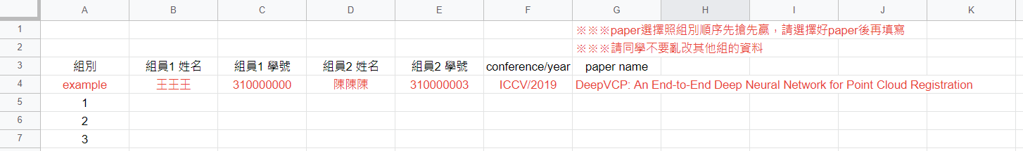
Requirement
A PowerPoint
A video to explain your slides
Upload to google drive, Youtube, etc…
Make sure we can access it (所有知道此連結的使用者都可以查看)
Put the link in your PowerPoint
Fill in google sheet : link (first come first served basis)

Slide 5
Deadline
Submit Deadline : about two weeks (07/12/2022 11:59 PM)
You need to submit your PPT to New E3
※This proposal is not scored.

Slide 6
Example
1. Which paper did you choose? (must include conference name/year)
2. What is the paper about? (You can give a brief introduction)
(Segmentation? Object detection ? NLP? Pruning?...)
3. What are you going to do?
Reimplementation of the paper?
A new application?
…….

Slide 7
Example --- Dataset
How can you get your dataset?
Collect them by yourself
Download from the Internet
……

Slide 8
Example --- Feasibility
Please show us that your final project is feasible
For example :
Can you get your dataset?
Can you train the model with the available resources?

